Slide 1
TensorFlow Gesture Recognition
Ram Bhattarai

Slide 2
TensorFlow Stands for
Tensor: Multidimensional Array
Flow: A Graph of operations

Slide 3
TensorFlow Overview
Open Source Machine Learning Library
Especially used for Deep Learning
Provides researchers and developers to easily build and deploy ML powered applications.

Slide 4
CNN- Convolutional Neural Network
Class of Deep neural network- Most commonly applied to analyzing visual imagery
Layers:
Convolutional
ReLu Layer
Pooling
Fully Connected

Slide 5
Before going deep into what each layer means
How CNN Works?
CNN compares images piece by piece and features or commonalities in images

Slide 6
Convolutional Layer- Math part
Step 1:
Extract features from the image
Step 2:
Multiply the each image pixel by the corresponding feature pixel
Step 3:
Add all the pixel values
Step 4: Divide by the total number of pixels
Repeat the process until you are done with all the features

Slide 7
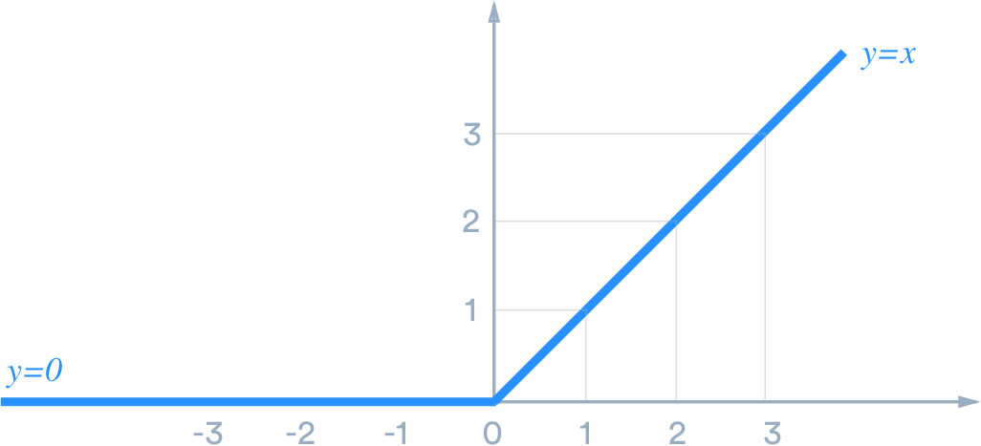
ReLu Layer: Rectified Linear Unit
f(x) = { 0 if x<0, x if x>=0}
Remove any negative values from the convolutional layer
Output
f(x) | f(x) = x | F(x)
-5 | f(-5) = 0 | 0
-1 | f(-1) = 0 | 0
1 | f(1) = 1 | 1
2 | f(2) = 2 | 2

Slide 8
Pooling Layer
Reduce the computational complexity of the model and pass on the values that are important.
Also called downsampling
Used to control the overfitting

Slide 9
Connected Layer
This is where all the neurons will be connected

Slide 10
Code Walkthrough
https://colab.research.google.com/drive/19DkmQ_8Lb8JsVLBLewK9agTC4TDAj54x#scrollTo=RvQFrQmV4hRH

Slide 11
Steps overview
Resize image
Apply convolution with activation layer ReLu
Pooling
Repeat the process multiple times
Connect all the neurons
Train
Test

Slide 12
Demo
https://drive.google.com/file/d/1Np2c2ZnPdm7rj0QJS31xIa3CdhXejwQy/view

